Slide 1
Arithmatic Operations
Floating Points (3.5)
Fallacies and Pitfalls (3.9)
Chapter 3 conclusion (3.10)

Slide 2
Floating Point
Representation for non-integral numbers
Including very small and very large numbers
Like scientific notation
–2.34 × 10⁵⁶
+0.002 × 10^{–4}
+987.02 × 10⁹
In binary
±1.xxxxxxx₂ × 2^{yyyy}
Types float and double in C
normalized
not normalized
Notes:
Normalized: only one digit before decimal point

Slide 3
Floating Point Standard
Defined by IEEE Std 754-1985
Developed in response to divergence of representations
Portability issues for scientific code
Now almost universally adopted
Two representations
Single precision (32-bit)
Double precision (64-bit)

Slide 4
IEEE Floating-Point Format
single: 8 bits double: 11 bits
single: 23 bits double: 52 bits
S
Exponent
Fraction
S: sign bit (0 ⇒ non-negative, 1 ⇒ negative)
Normalize significand: 1.0 ≤ |significand| < 2.0
Always has a leading pre-binary-point 1 bit, so no need to represent it explicitly (hidden bit)
Significand is Fraction with the “1.” restored
Exponent: excess representation: actual exponent + Bias
Ensures exponent is unsigned
Single: Bias = 127; Double: Bias = 1203
Notes:
127 is 01111111
-3/4 is -11/2 to power of 2 or -0.11 in binary or -1.1x2 to power of -1 normalized.
In IEEE single precision: (-1) to power 1 x (1 + .1000etc) x 2 to power of ((-1 + Bias) – Bias)
2s complement of -1:
1 in binary is 0001
It’s 1s complement is 1110
It’s 2s complement is 1110+1=1111
1111 + 1111=10000 in 2s complement
Or 01110 in binary
-1 + 127 = 126 or 0111..10

Slide 5
Floating-Point Example
Represent –0.75
–0.75 = (–1)¹ × 1.1₂ × 2^{–1}
S = 1
Fraction = 1000…00₂
Exponent = –1 + Bias
Single: –1 + 127 = 126 = 01111110₂
Double: –1 + 1023 = 1022 = 01111111110₂
Single: 1011111101000…00
Double: 1011111111101000…00

Slide 6
Floating-Point Example
What number is represented by the single-precision float
11000000101000…00
S = 1
Fraction = 01000…00₂
Fxponent = 10000001₂ = 129
x = (–1)¹ × (1 + 01₂) × 2^{(129 – 127)}
= (–1) × 1.25 × 2²
= –5.0
Notes:
Binary floating point to base 10 conversion:
First digit after decimal pt is ½,
Second digit is ¼ and so on.

Slide 7
Single-Precision Range
Exponents 00000000 and 11111111 reserved
Smallest value
Exponent: 00000001 ⇒ actual exponent = 1 – 127 = –126
Fraction: 000…00 ⇒ significand = 1.0
±1.0 × 2^{–126} ≈ ±1.2 × 10^{–38}
Largest value
exponent: 11111110 ⇒ actual exponent = 254 – 127 = +127
Fraction: 111…11 ⇒ significand ≈ 2.0
±2.0 × 2⁺¹²⁷ ≈ ±3.4 × 10⁺³⁸
Notes:
11111111 is infinity or NaNs (not a number)
00000000 is smaller than 2 to the power -126. Fraction will start with 0.something instead of 1. something.

Slide 8
Double-Precision Range
Exponents 0000…00 and 1111…11 reserved
Smallest value
Exponent: 00000000001 ⇒ actual exponent = 1 – 1023 = –1022
Fraction: 000…00 ⇒ significand = 1.0
±1.0 × 2^{–1022} ≈ ±2.2 × 10^{–308}
Largest value
Exponent: 11111111110 ⇒ actual exponent = 2046 – 1023 = +1023
Fraction: 111…11 ⇒ significand ≈ 2.0
±2.0 × 2⁺¹⁰²³ ≈ ±1.8 × 10⁺³⁰⁸
Notes:
Say soething about floating point arithmetic are not always precise.

Slide 9
Infinities and NaNs
Exponent = 111...1, Fraction = 000...0
±Infinity
Can be used in subsequent calculations, avoiding need for overflow check
Exponent = 111...1, Fraction ≠ 000...0
Not-a-Number (NaN)
Indicates illegal or undefined result
e.g., 0.0 / 0.0
Can be used in subsequent calculations

Slide 10
Denormal Numbers
Exponent = 000...0 ⇒ hidden bit is 0
Smaller than normal numbers
allow for gradual underflow, with diminishing precision
Denormal with fraction = 000...0
Two representations of 0.0!
Notes:
Denormal numbers has zero exponent but non zero fraction.

Slide 11
Floating-Point Addition
Consider a 4-digit decimal example
9.999 × 10¹ + 1.610 × 10^{–1}
1. Align decimal points
Shift number with smaller exponent
9.999 × 10¹ + 0.016 × 10¹
2. Add significands
9.999 × 10¹ + 0.016 × 10¹ = 10.015 × 10¹
3. Normalize result & check for over/underflow
1.0015 × 10²
4. Round and renormalize if necessary
1.002 × 10²

Slide 12
Floating-Point Addition
Now consider a 4-digit binary example
1.000₂ × 2^{–1} + –1.110₂ × 2^{–2} (0.5 + –0.4375)
1. Align binary points
Shift number with smaller exponent
1.000₂ × 2^{–1} + –0.111₂ × 2^{–1}
2. Add significands
1.000₂ × 2^{–1} + –0.111₂ × 2–1 = 0.001₂ × 2^{–1}
3. Normalize result & check for over/underflow
1.000₂ × 2^{–4}, with no over/underflow
4. Round and renormalize if necessary
1.000₂ × 2^{–4} (no change) = 0.0625

Slide 13
FP Adder Hardware
Much more complex than integer adder
Doing it in one clock cycle would take too long
Much longer than integer operations
Slower clock would penalize all instructions
FP adder usually takes several cycles
Can be pipelined

Slide 14
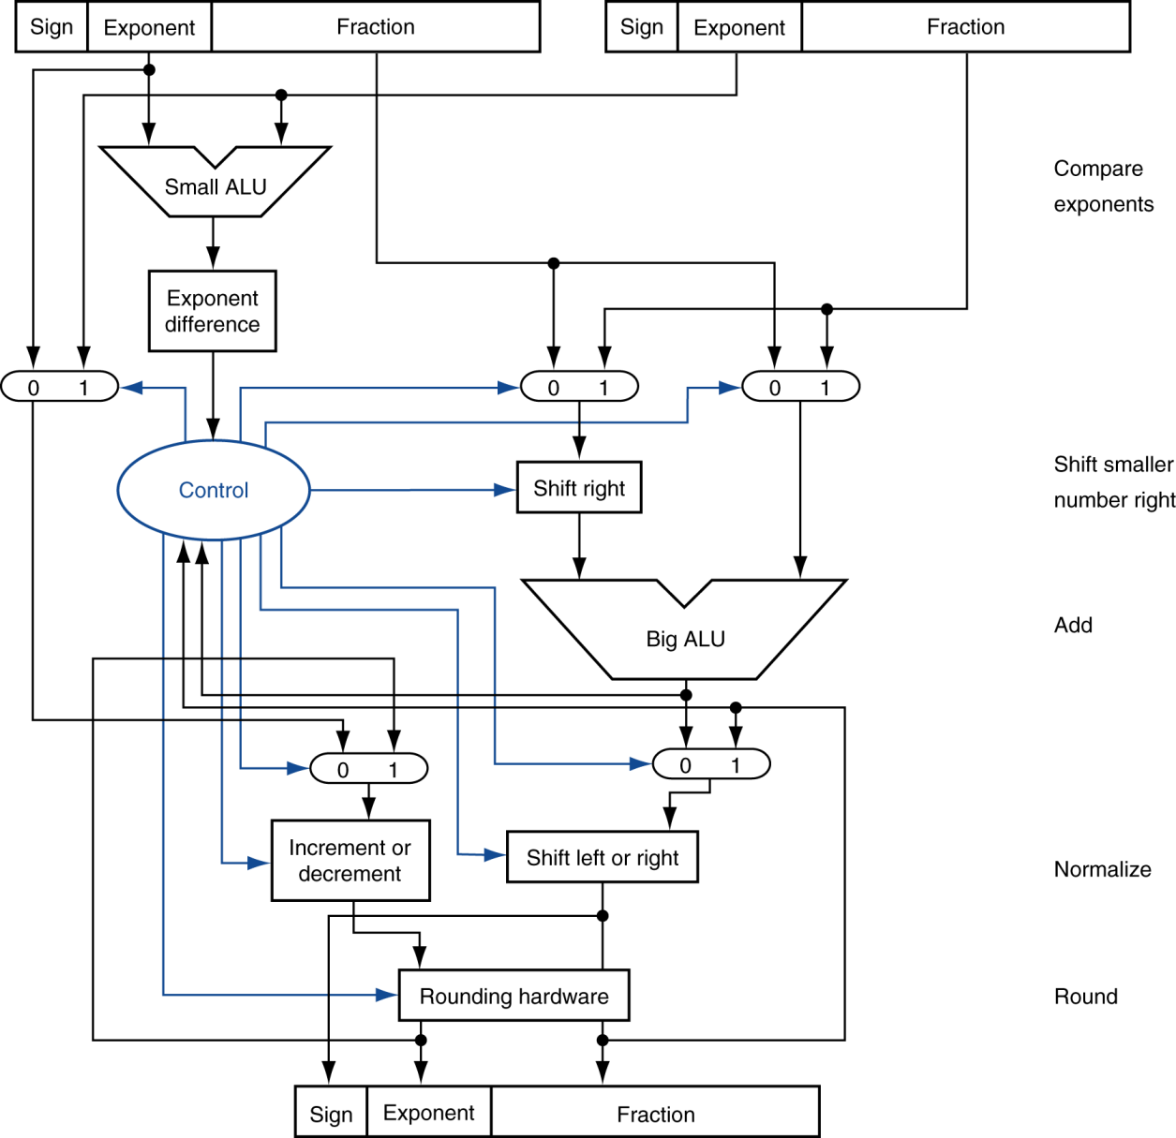
FP Adder Hardware
Step 1
Step 2
Step 3
Step 4

Slide 15
Floating-Point Multiplication
Consider a 4-digit decimal example
1.110 × 10¹⁰ × 9.200 × 10^{–5}
1. Add exponents
For biased exponents, subtract bias from sum
New exponent = 10 + –5 = 5
2. Multiply significands
1.110 × 9.200 = 10.212 ⇒ 10.212 × 10⁵
3. Normalize result & check for over/underflow
1.0212 × 10⁶
4. Round and renormalize if necessary
1.021 × 10⁶
5. Determine sign of result from signs of operands
+1.021 × 10⁶

Slide 16
Floating-Point Multiplication
Now consider a 4-digit binary example
1.000₂ × 2^{–1} × –1.110₂ × 2^{–2} (0.5 × –0.4375)
1. Add exponents
Unbiased: –1 + –2 = –3
Biased: (–1 + 127) + (–2 + 127) = –3 + 254 – 127 = –3 + 127
2. Multiply significands
1.000₂ × 1.110₂ = 1.1102 ⇒ 1.110₂ × 2^{–3}
3. Normalize result & check for over/underflow
1.110₂ × 2^{–3} (no change) with no over/underflow
4. Round and renormalize if necessary
1.110₂ × 2^{–3} (no change)
5. Determine sign: +ve × –ve ⇒ –ve
–1.110₂ × 2^{–3} = –0.21875

Slide 17
FP Arithmetic Hardware
FP multiplier is of similar complexity to FP adder
But uses a multiplier for significands instead of an adder
FP arithmetic hardware usually does
Addition, subtraction, multiplication, division, reciprocal, square-root
FP ↔ integer conversion
Operations usually takes several cycles
Can be pipelined

Slide 18
FP Instructions in MIPS
FP hardware is coprocessor 1
Adjunct processor that extends the ISA
Separate FP registers
32 single-precision: $f0, $f1, … $f31
Paired for double-precision: $f0/$f1, $f2/$f3, …
Release 2 of MIPs ISA supports 32 × 64-bit FP reg’s
FP instructions operate only on FP registers
Programs generally don’t do integer ops on FP data, or vice versa
More registers with minimal code-size impact
FP load and store instructions
lwc1, ldc1, swc1, sdc1
e.g., ldc1 $f8, 32($sp)

Slide 19
FP Instructions in MIPS
Single-precision arithmetic
add.s, sub.s, mul.s, div.s
e.g., add.s $f0, $f1, $f6
Double-precision arithmetic
add.d, sub.d, mul.d, div.d
e.g., mul.d $f4, $f4, $f6
Single- and double-precision comparison
c.xx.s, c.xx.d (xx is eq, lt, le, …)
Sets or clears FP condition-code bit
e.g. c.lt.s $f3, $f4
Branch on FP condition code true or false
bc1t, bc1f
e.g., bc1t TargetLabel

Slide 20
FP Example: °F to °C
C code:
float f2c (float fahr) { return ((5.0/9.0)*(fahr - 32.0)); }
fahr in $f12, result in $f0, literals in global memory space
Compiled MIPS code:
f2c: lwc1 $f16, const5($gp) lwc2 $f18, const9($gp) div.s $f16, $f16, $f18 lwc1 $f18, const32($gp) sub.s $f18, $f12, $f18 mul.s $f0, $f16, $f18 jr $ra
Notes:
$fn is a floating point register
Lwc1 loads a floating point register

Slide 21
FP Example: Array Multiplication
X = X + Y × Z
All 32 × 32 matrices, 64-bit double-precision elements
C code:
void mm (double x[][], double y[][], double z[][]) { int i, j, k; for (i = 0; i! = 32; i = i + 1) for (j = 0; j! = 32; j = j + 1) for (k = 0; k! = 32; k = k + 1) x[i][j] = x[i][j] + y[i][k] * z[k][j]; }
Addresses of x, y, z in $a0, $a1, $a2, and i, j, k in $s0, $s1, $s2

Slide 22
FP Example: Array Multiplication
MIPS code:
li $t1, 32 # $t1 = 32 (row size/loop end) li $s0, 0 # i = 0; initialize 1st for loop L1: li $s1, 0 # j = 0; restart 2nd for loop L2: li $s2, 0 # k = 0; restart 3rd for loop sll $t2, $s0, 5 # $t2 = i * 32 (size of row of x) addu $t2, $t2, $s1 # $t2 = i * size(row) + j sll $t2, $t2, 3 # $t2 = byte offset of [i][j] addu $t2, $a0, $t2 # $t2 = byte address of x[i][j] l.d $f4, 0($t2) # $f4 = 8 bytes of x[i][j] L3: sll $t0, $s2, 5 # $t0 = k * 32 (size of row of z) addu $t0, $t0, $s1 # $t0 = k * size(row) + j sll $t0, $t0, 3 # $t0 = byte offset of [k][j] addu $t0, $a2, $t0 # $t0 = byte address of z[k][j] l.d $f16, 0($t0) # $f16 = 8 bytes of z[k][j] …

Slide 23
FP Example: Array Multiplication
… sll $t0, $s0, 5 # $t0 = i*32 (size of row of y) addu $t0, $t0, $s2 # $t0 = i*size(row) + k sll $t0, $t0, 3 # $t0 = byte offset of [i][k] addu $t0, $a1, $t0 # $t0 = byte address of y[i][k] l.d $f18, 0($t0) # $f18 = 8 bytes of y[i][k] mul.d $f16, $f18, $f16 # $f16 = y[i][k] * z[k][j] add.d $f4, $f4, $f16 # f4=x[i][j] + y[i][k]*z[k][j] addiu $s2, $s2, 1 # $k k + 1 bne $s2, $t1, L3 # if (k != 32) go to L3 s.d $f4, 0($t2) # x[i][j] = $f4 addiu $s1, $s1, 1 # $j = j + 1 bne $s1, $t1, L2 # if (j != 32) go to L2 addiu $s0, $s0, 1 # $i = i + 1 bne $s0, $t1, L1 # if (i != 32) go to L1

Slide 24
Accurate Arithmetic
IEEE Std 754 specifies additional rounding control
Extra bits of precision (guard, round, sticky)
Choice of rounding modes
Allows programmer to fine-tune numerical behavior of a computation
Not all FP units implement all options
Most programming languages and FP libraries just use defaults
Trade-off between hardware complexity, performance, and market requirements

Slide 25
Right Shift and Division
§3.9 Fallacies and Pitfalls
Left shift by i places multiplies an integer by 2^{i}
Right shift divides by 2^{i}?
Only for unsigned integers
For signed integers
Arithmetic right shift: replicate the sign bit
e.g., –5 / 4
11111011₂ >> 2 = 11111110₂ = –2
Rounds toward –∞
c.f. 11111011₂ >>> 2 = 00111110₂ = +62

Slide 26
Associativity
Parallel programs may interleave operations in unexpected orders
Assumptions of associativity may fail
Need to validate parallel programs under varying degrees of parallelism

Slide 27
Who Cares About FP Accuracy?
Important for scientific code
But for everyday consumer use?
“My bank balance is out by 0.0002¢!” ☹
The Intel Pentium FDIV bug
The market expects accuracy
See Colwell, The Pentium Chronicles

Slide 28
Concluding Remarks
§3.9 Concluding Remarks
Bits have no inherent meaning
Interpretation depends on the instructions applied
Computer representations of numbers
Finite range and precision
Need to account for this in programs

Slide 29
Concluding Remarks
ISAs support arithmetic
Signed and unsigned integers
Floating-point approximation to reals
Bounded range and precision
Operations can overflow and underflow
MIPS ISA
Core instructions: 54 most frequently used
100% of SPECINT, 97% of SPECFP
Other instructions: less frequent

